Slide 1
Behavioral Robustness of Software System Designs
Changjian Zhang

Slide 2
What is Robustness?
Software systems are designed and implemented with respect to certain specifications.
A specification makes assumptions about the operating environment and claims guarantees on certain functionalities.
Robustness, a system should continue to provide the guaranteed functionalities under unexpected environment.

Slide 3
What is Robustness?
IEEE: Robustness is the ability of a software system to continue functioning correctly in the presence of invalid inputs or stressful environment.
Avizienis et al.: Robustness is a secondary attribute of dependability, i.e., dependability with respect to external faults.

Slide 4
Robustness in Different Domains
The meaning and measure of robustness become overloaded in different domains.
Classes of Systems:
Conventional Software Systems.
Machine Learning Systems.
Cyber-Physical Systems.
Notes:
Use figures, architecture diagrams, to show the difference of different classes systems.

Slide 5
Robustness in Conventional Systems
Behaviors of which often represented as logic procedures or state-transition systems, such as OS, web services, etc.
Target: A function procedure, a software component, a system with several running components.
Faults: Invalid inputs, faulty events: message loss, server failure, etc.
Property: Function correctness, invalid outcomes, failure, or crash.
Measure: Often in binary notion.

Slide 6
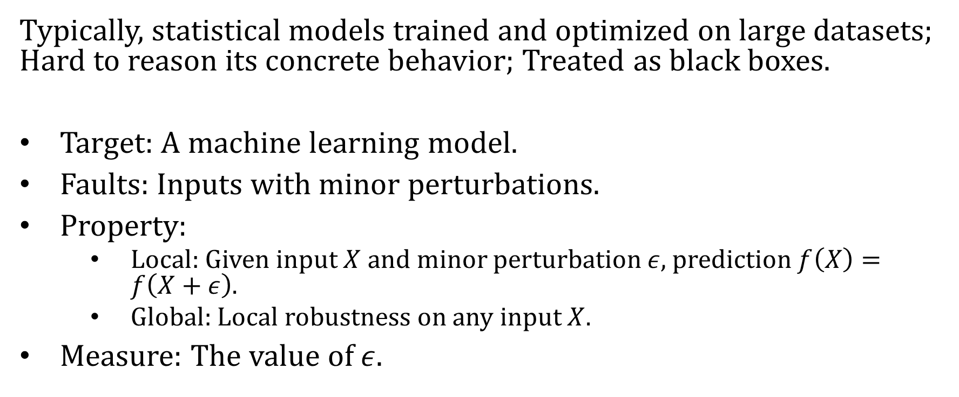
Robustness in ML
Typically, statistical models trained and optimized on large datasets; Hard to reason its concrete behavior; Treated as black boxes.
Target: A machine learning model.
Faults: Inputs with minor perturbations.
Property:
Local: Given input $X$ and minor perturbation $ε$, prediction $f\left(X\right)=f\left(X+ε\right)$.
Global: Local robustness on any input $X$.
Measure: The value of $ε$.
Notes:
Talk about Verifiai

Slide 7
Robustness in CPS
CPS involve model, control, and manipulation of physical processes, where behaviors are often represented in DE or hybrid logics.
Target: A control agent.
Faults: Changes in physical dynamics, errors in modeling, observations, or actuations.
Property: The controlled system satisfies certain properties, such safety, or stability.
Measure: Level of errors; level of changes in system parameters or dynamics.

Slide 8
How is Robustness Evaluated?
Conventional Systems: Testing or model-based testing are the primary method; less focus on formal reasoning.
ML Systems: Testing or post-certification of robustness (optimization-based); active research in formal certification.
CPS: Focus more on control, such as robust control, robust RL.

Slide 9
Gaps
Lack a view of system and behavior:
Focus only on invalid or errors in inputs and measure the correctness of the outcomes of a single procedure or component.
Lack a view of design:
Most work are experimental and rely on testing against an implementation.
Defects found in later phases result in a larger cost of fixes.
Less focus on formal reasoning with more rigorous guarantees:
Testing based methods often provide guarantees on violations but not no-violations.
Binary notion of robustness.
Notes:
Other: mismatched formalism, like CPS.

Slide 10



Motivation: Robust-by-Design
Formal methods also provide systematic and rigorous reasoning.
Formal models are suitable for representing software designs.
Design
Robustness
Analysis
Developer, Designer,
Architect
It is also suitable for automatic redesign generation.
Robustify
Design

Slide 11
Approach Overview
A behavioral notion of software robustness:
Target: Behavior models in labeled transition systems.
Faults: Deviations of behavior as sequences of events.
Property: System safety property
Measure: qualitatively measure the set of tolerable deviations.
Robustification tactics:
Architecture tactics for robustness (future work).
Automated robustification.

Slide 12
Thesis Statement
Given systems and environments that can be formally modeled in state-transition systems, we can systematically measure and improve the behavioral robustness with respect to a system-level safety property.

Slide 13
Expected Contributions
We propose a behavioral notion of robustness for software systems based on labeled transition systems.
We propose an approach to compute and represent the behavioral robustness of a system.
We identify architecture tactics that can improve the robustness of a system against behavioral environmental deviations with formal justifications.

Slide 14
Expected Contributions (cont.)
We propose an approach to automatically robustify a system by applying certain architecture tactics.
We implement the proposed approaches in a tool that can efficiently compute the robustness and robustify a design and evaluate the applicability of our approaches in several case studies.
Notes:
Automate graceful degradation.

Slide 15
Prior Work
We propose a behavioral notion of robustness for software systems based on labeled transition systems.
We propose an approach to compute and represent the behavioral robustness of a system.
We propose an approach to automatically robustify a system by applying certain architecture tactics.

Slide 16
Future Work
Compute robustness for decomposed systems.
Identify architecture tactics that can improve the robustness of a system against behavioral environmental deviations with formal justifications.

Slide 17
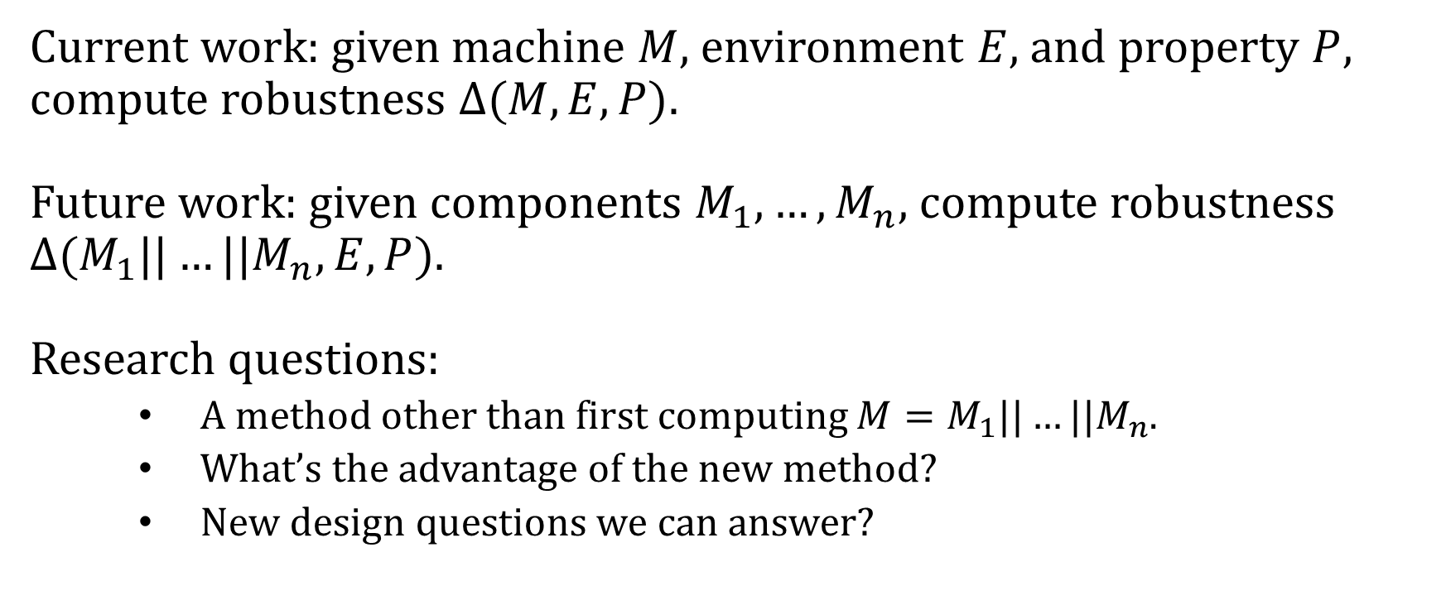
Robustness Computation for Decomposed Systems
Current work: given machine $M$, environment $E$, and property $P$, compute robustness $Δ(M,E,P)$.
Future work: given components $M_{1},…,M_{n}$, compute robustness $Δ(M_{1}||…||M_{n},E,P)$.
Research questions:
A method other than first computing $M=M_{1}||…||M_{n}$.
What’s the advantage of the new method?
New design questions we can answer?

Slide 18
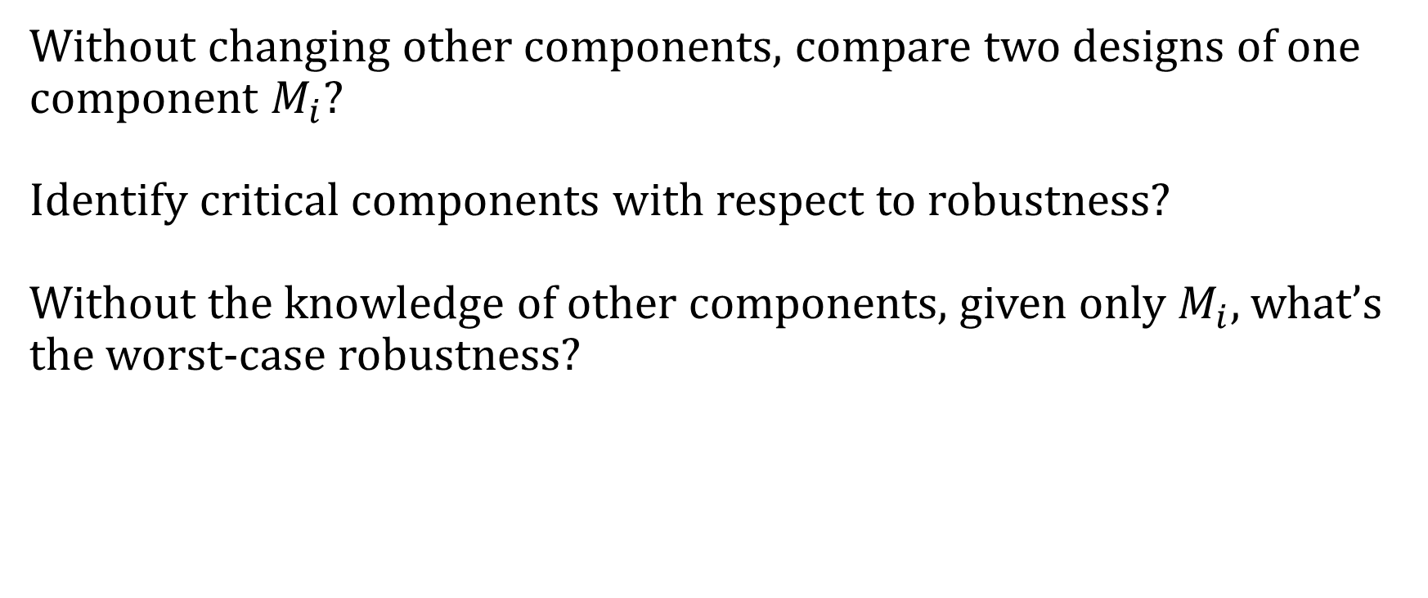
New Design Questions
Without changing other components, compare two designs of one component $M_{i}$?
Identify critical components with respect to robustness?
Without the knowledge of other components, given only $M_{i}$, what’s the worst-case robustness?
Notes:
How this would affect development process?
Emerging effect?

Slide 19
Architecture Tactics
Wrapper (add a controller, disable only).
Graceful degradation (remove/degrade components, properties).
Redundancy (Simplex architecture, voting).
Pre/Post processing (prevent or stop the propagation of errors by rewriting).

Slide 20
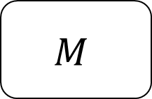
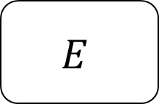
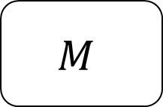


Wrapper: Architecture Pattern
$$E$$
$$E$$
$$C$$
$$M$$
$$M$$

Slide 21
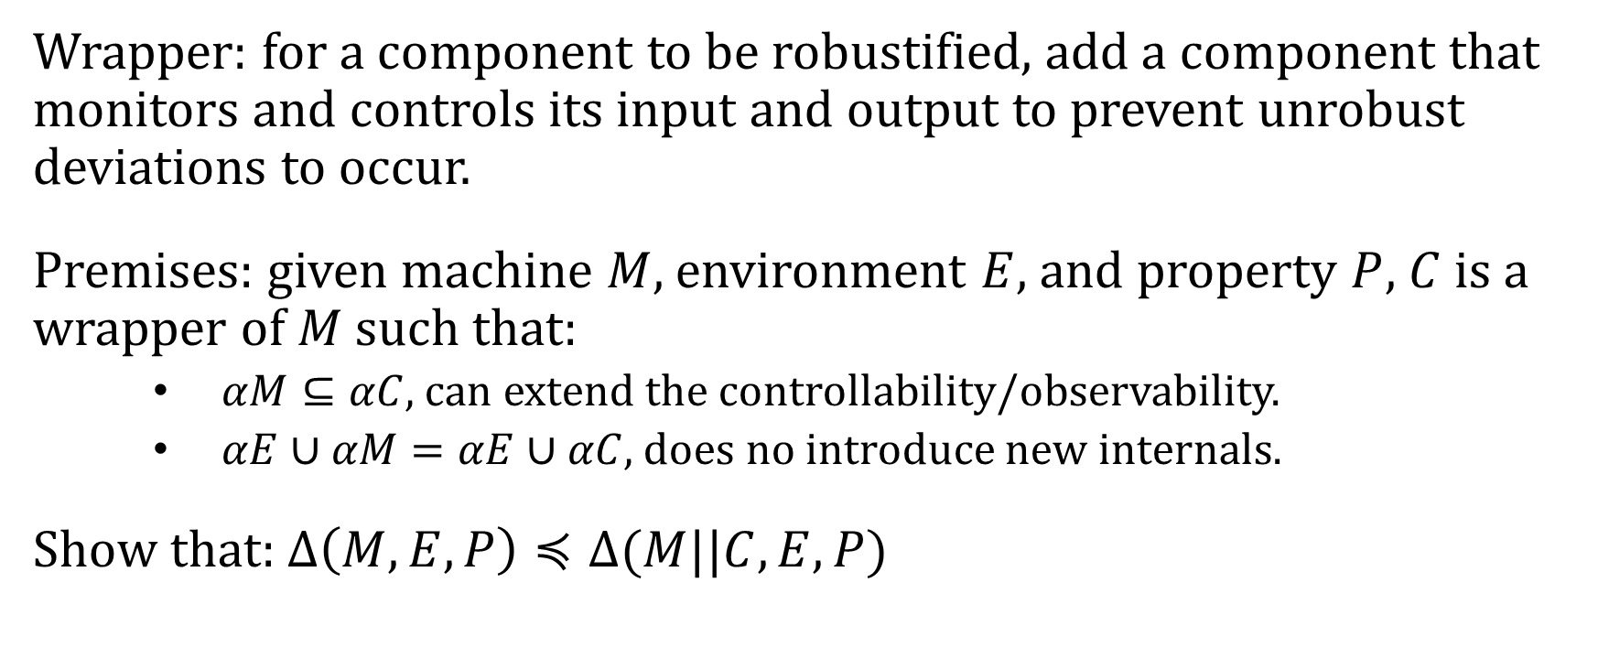
Wrapper: Formal Justification
Wrapper: for a component to be robustified, add a component that monitors and controls its input and output to prevent unrobust deviations to occur.
Premises: given machine $M$, environment $E$, and property $P$, $C$ is a wrapper of $M$ such that:
$αM⊆αC$, can extend the controllability/observability.
$αE∪αM=αE∪αC$, does no introduce new internals.
Show that: $Δ\left(M,E,P\right)≼Δ(M||C,E,P)$

